Slide 1


Team 18: Kubernetes
Based Attacks
Bi-Weekly Update 1 Thomas Gumienny, Patrick Churchill, Albert Ma Sponsor: Sandip Roy TA: Sabyasachi Gupta
Notes:
Michelle

Slide 2
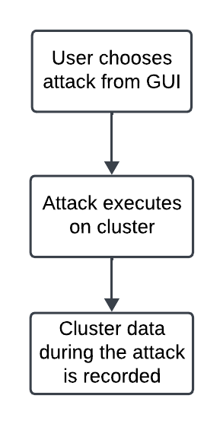
Project Summary
The US Navy is using Kubernetes to manage software. However, as a relatively new cyberservice, Kubernetes has a variety of cybersecurity weaknesses.
Develop a Kubernetes testbed that can simulate and collect the data of common types of attacks.
Notes:
Kyle

Slide 3
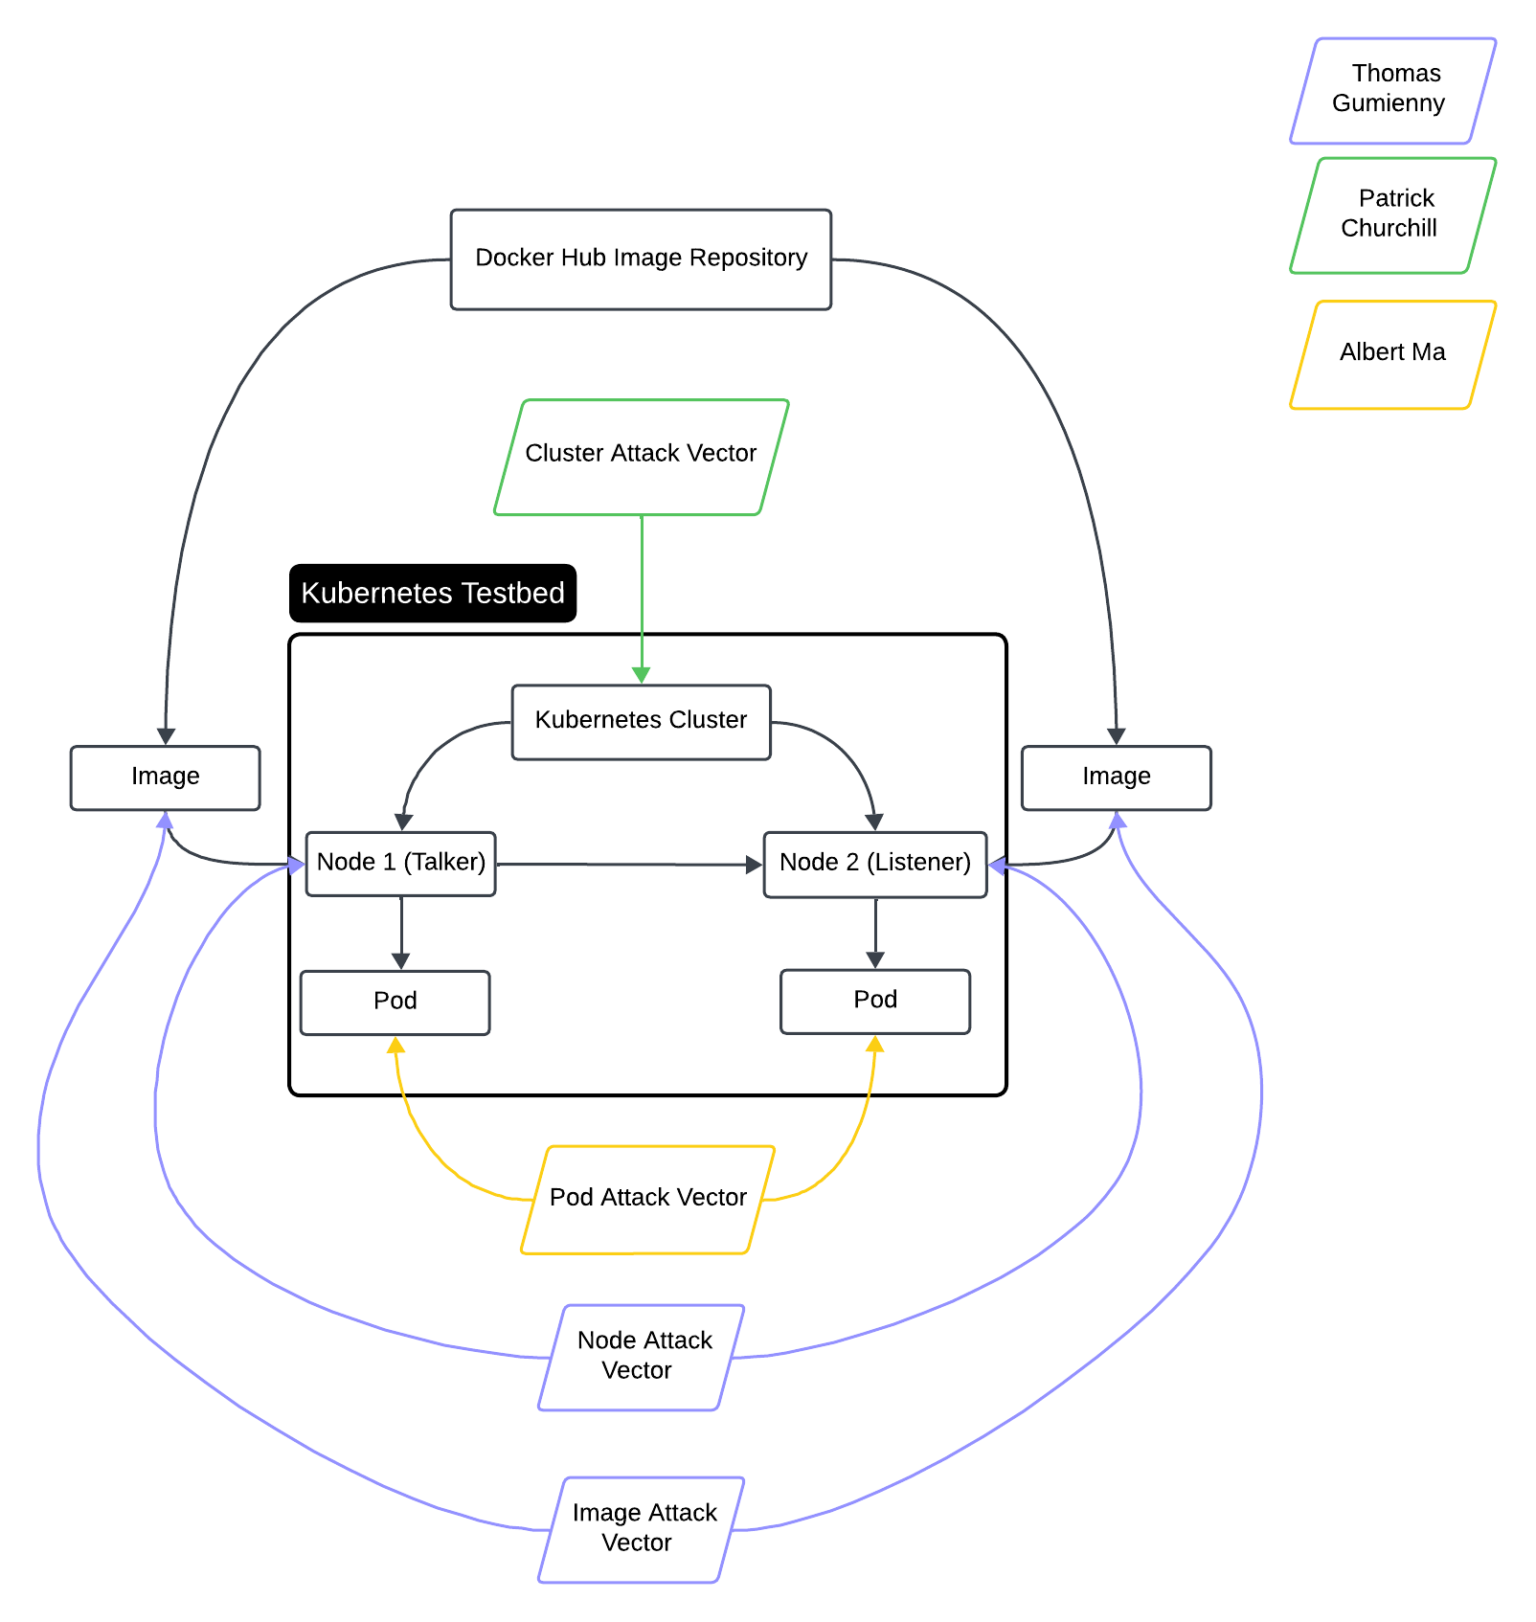
Project/Subsystem Overview
Thomas Gumienny - Image Attack
Image has similar name to normal docker image
When run, image consumes CPU/GPU resources
Albert Ma - Pod Attack
Set up target pod, and conduct reconnaissance on network for open ports
Gain access to target pod and container
Patrick Churchill - Cluster Attack
Server Node applies pods upon Agent Node that overload the memory and CPU on Server Node, causing it to crash
Notes:
Eric

Slide 4
Major Project Changes for 404
Our sponsor decided to put off development of defenses to our attacks
The cluster interact with itself more.
The testbed will have a simple GUI to execute attacks and measure cluster data during attacks.
Notes:
Eric

Slide 5
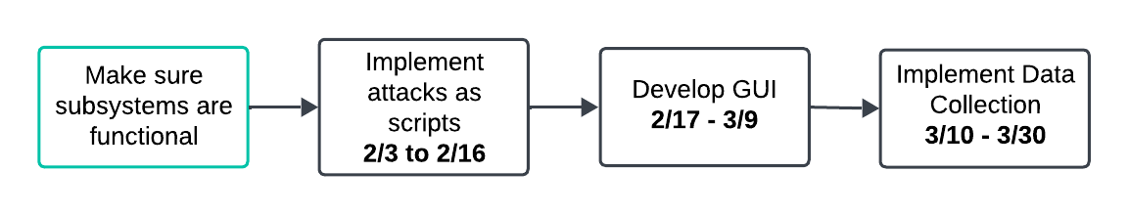
Project Timeline
Notes:
Eric

Slide 6
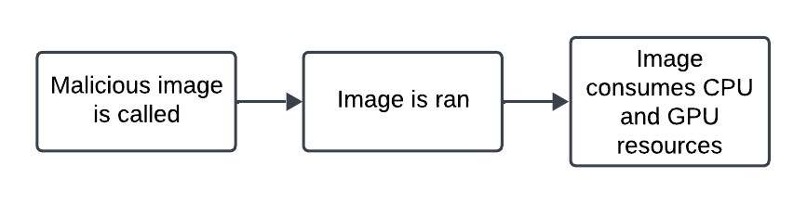
Image Attack Vector
Thomas Gumienny
Accomplishments since 403 1 hrs of effort | Ongoing progress/problems and plans until the next presentation
Image Attack still runs from the command line and has same effects as in 403 | Make cluster more of an ecosystem by incorporating data reading Determine GUI to use

Slide 7
Node Attack Vector
Patrick Churchill
Accomplishments since 403 1 hrs of effort | Ongoing progress/problems and plans until the next presentation
Node Attack still configures and overloads the Agent Node from the Server Node(same effect as end of 403) | Research ways to run attack without “sudo” access. Strengthen cluster by adding more pods/applications related to measurement and accessibility

Slide 8
Pod Attack Vector
Albert Ma
Accomplishments since 403 1.5 hrs of effort | Ongoing progress/problems and plans until the next presentation
Issues in setting up the target attack have arisen, apparently because of a bug in connecting the local host to the api nmap command for sniffing the network for open ports appears to work without issues | Debug the localhost-api connectivity issue (this week) Get the attack vector to access information from the target container/application again Extract the information it can access and log it Make the extracted info to usable data

Slide 9
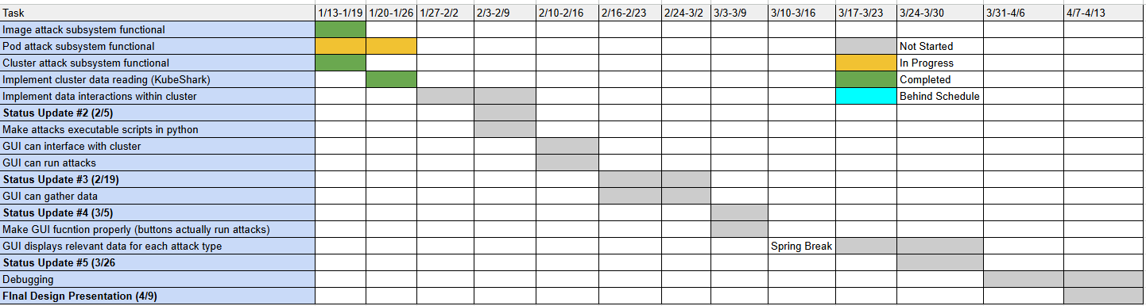
Execution Plan
Notes:
Michelle

Slide 10
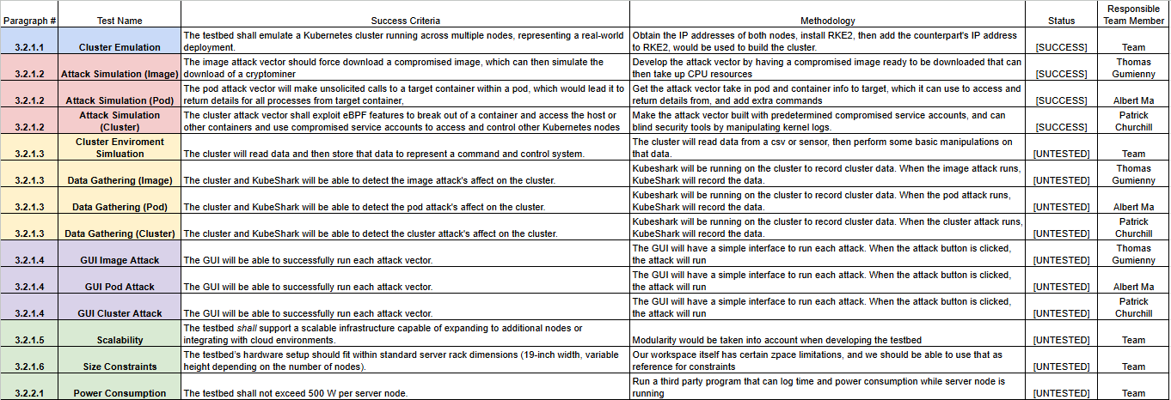
Validation Pan
Notes:
Michelle

Slide 11
Thank You

